Slide 1
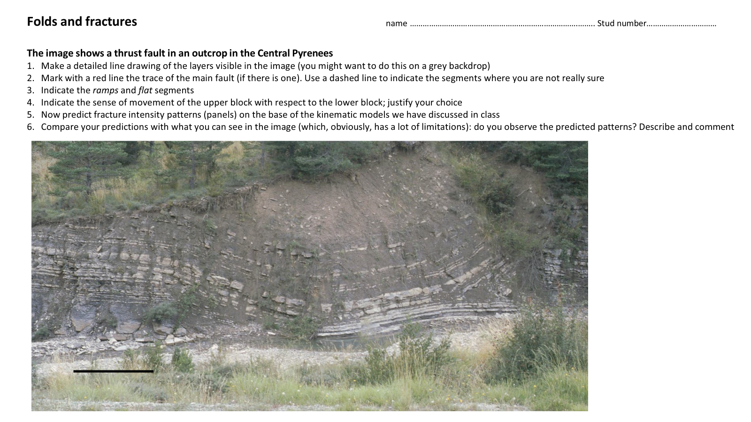

Slide 2
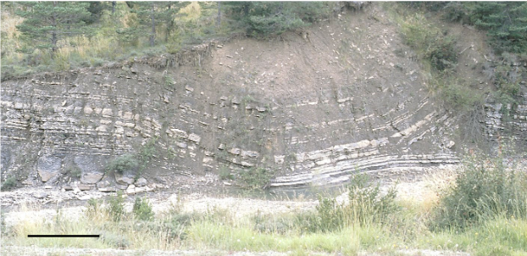
HW Flat
HW Flat
HW Flat
FW Ramp
FW flat
HW Ramp
HW Flat
FW Flat

